Slide 1
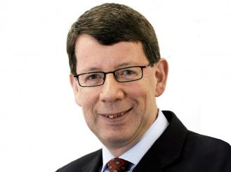
H o n o r a r y M e m b e r s h i p
Prof. David Kerr

Slide 2
H o n o r a r y M e m b e r s h i p
Medical and science degrees
1980 - | MBChB | University of Glasgow
1987 - | MD | University of Glasgow
1990 - | MSc | In Clinical Pharmacology
1990 - | PhD | Regulation of proliferation of breast cancer cells by growth factors
1996 - | DSc | The molecular and clinical pharmacology of anticancer therapy
2002 - | MA | University of Oxford

Slide 3
H o n o r a r y M e m b e r s h i p
Medical Oncology Carreer
1984 - 1992 | University of Glasgow
1990 - present | Honorary Professor of Pharmacology, University of Strathclyde
1992 - 2001 | University of Birmingham
2001 - present | University of Oxford
2009 - 2010 | Sidra Medical and Research Centre, Doha, Qatar (leave of absence)
2009 - 2011 | President, European Society of Medical Oncology
2010 - | Professor of Cancer Medicine, Oxford University Hospitals Trust
2010 - 2012 | Seconded as Health Adviser to Sec State for Health ,UK
2015 - | Honorary Professor, 2nd Military University of Shanghai
2015 - | Honorary Professor, University of Xiamen
2015 - | Editor in Chief, Journal of Global Oncology

Slide 4
H o n o r a r y M e m b e r s h i p
Honours and Fellowships
1995 | Elected Fellow of Royal College of Physicians and Surgeons, Glasgow (FRCP, Glas)
1996 | Elected Fellow of Royal College of Physicians, London (FRCP, Lon)
2000 | Elected Fellow of Academy of Medical Sciences (FMed Sci)
2002 | Awarded Commander of Order of British Empire, by HM the Queen (CBE)
2007 | Elected Honorary Fellow of Royal College of General Practitioners (FRCGP)
2009 | Elected Founding Fellow of European Academy of Cancer Sciences (FCanSci)
2010 | Elected Fellow of Royal College of Physicians, Edinburgh (FRCP, Edin)
2011 | Adjunct Professor of Medicine, Weill-Cornell College of Medicine (NY)
2016 | Honorary Prof of Oncology, 2nd Military University of Shanghai
2016 | Honorary Prof of Oncology, Xiamen University

Slide 5
H o n o r a r y M e m b e r s h i p
International collaborations
USA | He is in NIH’s Translational Research working group as the overseas member and have established a series of collaborations with the USA’s major cancer research centres (Mayo Clinic, MD Anderson, Memorial Sloan Kettering and Dana Farber, Harvard).
INDIA | He constructed a network of India’s top 10 cancer centres, in partnership with Oxford. This collaboration will provide training opportunities for Indian investigators in Oxford and will build an internationally competitive clinical research network (www.indox.org.uk).
EUROPE | He co-chaired the Entente Cordiale Celebrations on behalf of HM the Queen and President Chirac, 2003-2005. As President of ESMO (2010-2012) He was in a strong position to improve standing of Medical Oncology in Europe and sit on the Dutch government’s central committee for translational research.
AFRICA | He has established a consortium to develop cancer control programmes in Sub Saharan Africa and created AfrOx (www.afrox.org) the vehicle to implement change.
FAR EAST | He has established OxOnics, a drug development. It has a mission to bring novel anti-cancer agents to the Asia-pacific rim with a focus on China.

Slide 6
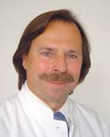
H o n o r a r y M e m b e r s h i p
György you asked me about what comes first to my mind when thinking of David Kerr
“David Kerr is one of the most influential, innovative and successful experimental and clinical researcher in the european oncology over the past 20-30 years. By his work and his functions in the European societies, in particular as EIC of “AnnOncology” and ESMO-president, he contributed substantially to the development of medical oncology in Europe; beyond this, his impact on the development of health system and oncology treatment of the poor countries in the world is really strong and valuable. David is not only a very good friend, but also an important and highly valuable partner of the board of Honorary Members of the Hungarian Society of Clinical Oncology.”
Hans Joachim Schmoll

Slide 7
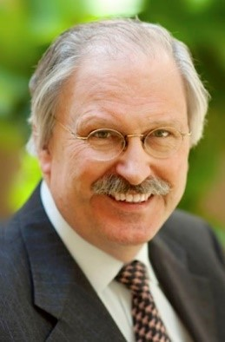
H o n o r a r y M e m b e r s h i p
György you asked me about what comes first to my mind when thinking of David Kerr
“I know David already for many years, but we met only a few times over those years. I know from the time he was editor-in-Chief of Annals of Oncology, when he was member of the ESMO Board and was President of ESMO. Moreover, we worked together on the Oxford Textbook of Oncology, one of the most important multidisciplinary textbooks in oncology today, of which he was the co-editor. He is a strong networker, with leadership capacity, is a kind person to talk with and excellent person to drink a beer with. I wholeheartedly welcome him into our illustrious family.”
Jan Vermorken

Slide 8
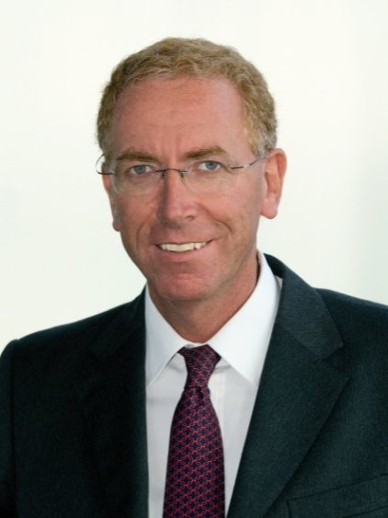
H o n o r a r y M e m b e r s h i p
György you asked me about what comes first to my mind when thinking of David Kerr
“Very well deserved election to Honorary Member of the Society: David is an excellent example of merging between strong personal contribution to highly sophisticated translational research and a planetary vision of the problems of oncology from both scientific , clinical and social prospectives.”
Alberto Sobrero

Slide 9
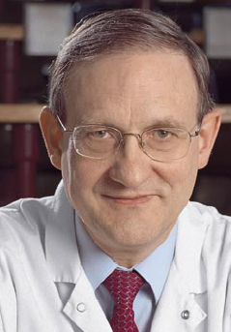
H o n o r a r y M e m b e r s h i p
György you asked me about what comes first to my mind when thinking of David Kerr
“David is a highly Qualified Academic Skilled And Respectable. He is obviously the first global world oncologist: Oxford, Scotland, England, UK being too small for him. He has already reconquered the Commonwealth: middle East, India, Africa… His goal is now the universe with its galaxies, black holes and quasars! …………….
Aimery de Gramont

Slide 10
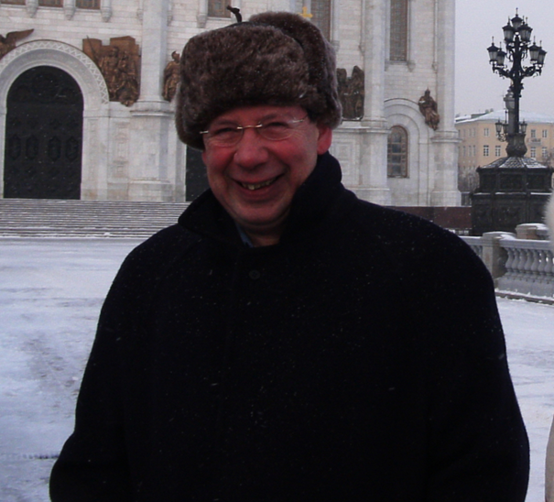
H o n o r a r y M e m b e r s h i p
Between us, it is for life since we visited Lenin in 2004 after an overdose of Vodka.
Welcome to the top Society. Aimery

Slide 11
H o n o r a r y M e m b e r s h i p
If someone asks why Professor David Kerr was selected to become a Honorary Member of the Hungarian Society of Clinical Oncology?
The answer is easy:

Slide 12
H o n o r a r y M e m b e r s h i p
He is one of the most influential, innovative and successful experimental and clinical researcher in the european oncology
He is a strong networker, with leadership capacity
He has a planetary vision of the problems of oncology
He has already reconquered the Commonwealth: middle East, India, Africa…
His goal is now the universe with its galaxie…………
Excellent person to drink a beer or an overdose of Vodka with

Slide 13
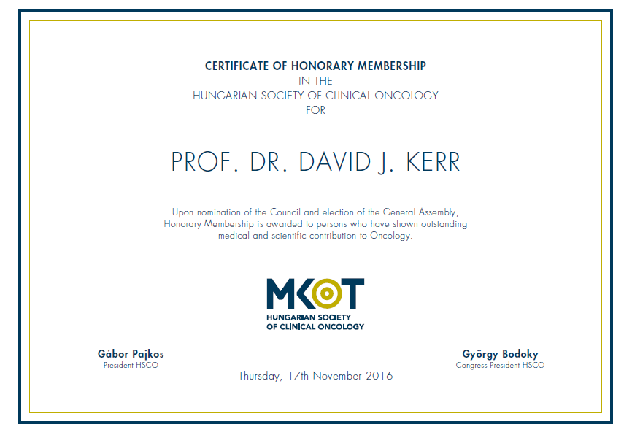

Slide 14
